Slide 1

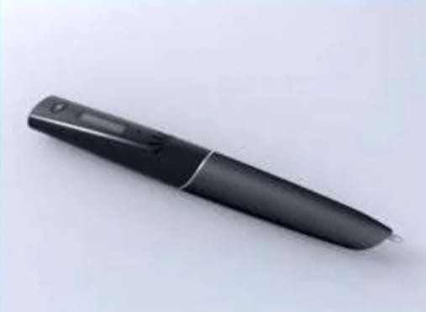
SMART NOTE TAKER Presented By B . Manichandana 20H51A05N0 CSE-3rd Year

Slide 2
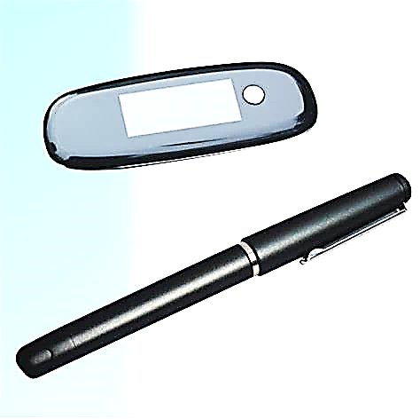
CONTENT:
Introduction
Features
Construction
Working process
Advantage
Disadvantage
Conclusion
Reference

Slide 3
Introduction
Smart note taker is one of useful product which can satisfy the needs of people in today’s technological and fast life.
It is a pen that provides taking fast and easy notes to people who are busy one’s self with something.
The written notes will be stored in the memory chip of the pen and will be able to read in digital medium after the job is done.
Note taking is more essential component for educational and professional career .
The Smart Note Taker is good and helpful for the blind who can’t see but can think and write freely.
It is also useful especially for the instructors during their presentations. The instructors may not want to present the lecture on the board
The product can also sense 3D shapes and motions that the user tries to draw. The sensed information will be processed and transferred to the memory chip and then will be monitored on the display device.

Slide 4
Features
The SNT is good and helpful for blinds who can think and write freely.
It is also useful for instructors in presentations . if the instructors may not want to present the lecture in front of board.
The drawn figure can be processed and directly sent to the server computer.
The server computer then can processed and transform the drawn shape through network to all of the computers.
By this way lectures are aimed to be more efficient and fun.
It uses java software.
It recognizes up to 22 languages :English-Canada , English-US , germen , simplified Chinese , traditional Chinese , Danish , Spanish , French , Greek , Italian , Japanese , Dutch, Portuguese , Russian , Swedish etc.

Slide 5
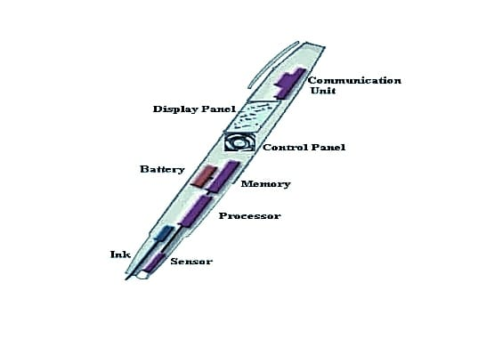
Construction
INTERNAL STRUCTURE

Slide 6
CONSTRUCTION
Sensors
> Displacement sensor
>which sense the displacement of the pen
>displacement sensors detect the amount of displacement when objects move from one position to another.
Processor
>contain data base system and driver software.
Memory
>stores the written notes in air
Control Panel
>controls the mode of operation in smart note taker
Battery
>rechargeable battery is used in smart note taker
Communication Unit
>functions like communication port , uses to communicate with pc , laptop etc..

Slide 7
Working Process
The product will be able to sense 3d shapes and motions that the users try to draw.
When we write the notes the displacement sensor senses displacement of the pen.
The system installed in the pen will consist of a database
The sensed structure is compared with the standard alphabets in database.
which will help the processor to recognize various words made visually in the air.
The SNT includes JAVA applet.
Applet is a function of java , is a kind of container which contains a set of programs made in java
The java code that will develop can also be installed in the processor of the pen and will monitors the notes and display the desired text or drawings by using display panel.
This stored data is upload to pc using USB.
Then we can see the notes.

Slide 8
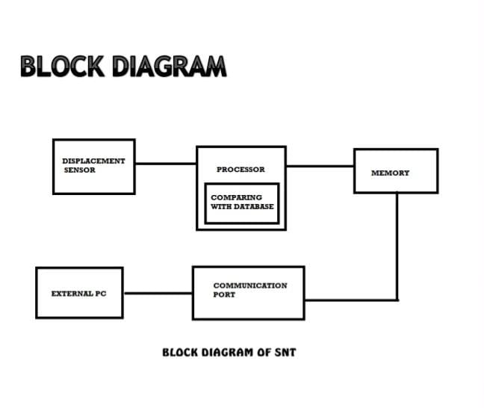

Slide 9
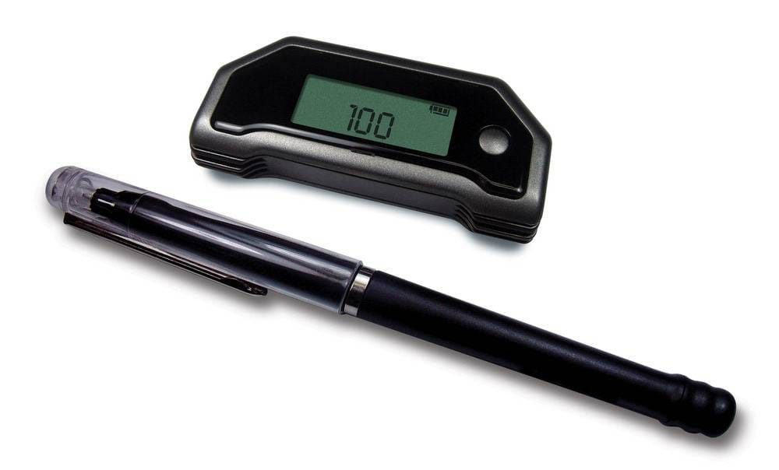
Advantages
Smart note taker is reliable and powerful.
It is helpful for blinds that think and write freely.
Easy to use wireless connection.
It is time saving.
Smart note taker is used for instructors in presentations.
Light weighted.

Slide 10
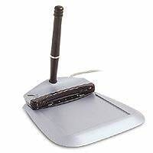
Disadvantage
Cost of the pen is very high (50-90$ for 2D pen,2000$ for 3D pen).
No templates formats available.
Can't drag items to other tabs directly.
Slower processing.

Slide 11
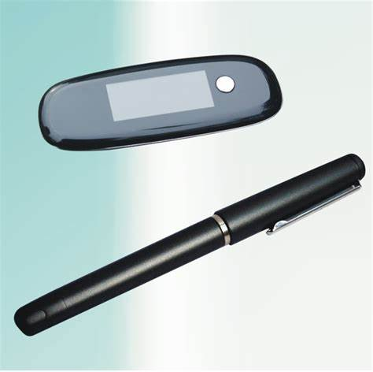

Conclusion
From this we can conclude that our product has many advantages over digital pen and note taker , since the smart note taker is a device that can store visual recordings and thus can be used widely.

Slide 12
Reference
https://www.slideshare.net/mansichauhan33234/smartnotetaker-120306091230phpapp02-41356618>
https://www.seminarsonly.com/computer%20science/Smart%20Note%20Taker.php
http://www.campus-technology.com
http://www.newscientist.com
http://www2.smarttech.com/st/enUS/Products/Interactive+Pen+Displays
http://www.pegatech.com

Slide 13
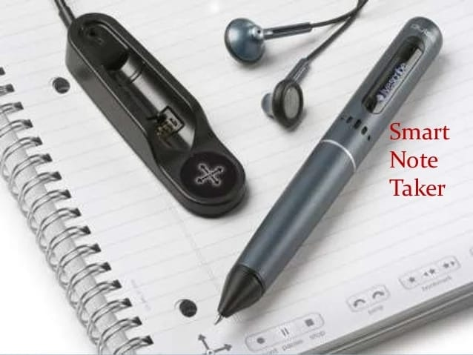
THANK YOU

